Slide 1

Preprocessing (from reads to a count matrix)
Susan Kloet
23 October 2023
Slides courtesy of:
Roberta Menafra
Bioinformatician LGTC

Slide 2
Preprocessing (from reads to a count matrix)
In DNA sequencing, a read is an inferred sequence of base pairs corresponding to all or part of a single DNA fragment.
In this lecture
Sequencing data formats
Data pre-processing
10X Genomic pipeline (Cell Ranger)
Example outputs

Slide 3
Preprocessing (from reads to a count matrix)
Get bcl files
Create fastq files
Overall QC (optional adapter trimming)
Align fastq to genome→SAM/BAM file
Quantify and collapse UMI
Final count matrix

Slide 4
Common file formats in NGS
bcl
fastq
bam
mtx, tsv
hdf5 (.h5, .h5ad)
Get bcl files
Create fastq files
Overall QC (optional adapter trimming)
Align fastq to genome→SAM/BAM file
Quantify and collapse UMI
Final count matrix
BCL
Raw data files in binary base call format.
Illumina offers bcl2fastq Conversion Software to convert BCL files.
bcl2fastq is included, standalone conversion software that demultiplexes data and converts BCL files to standard FASTQ file formats for downstream analysis.

Slide 5
Sample demultiplexing
Sequence runs on NGS instruments are typically carried out with multiple samples pooled together.
An index tag (also called a barcode) consisting of a unique sequence (between 6 and 12bp) is added to each sample so that the sequence reads from different samples can be identified.
The other requirement is a sample sheet
[Header],,,,,,,,,
IEMFileVersion,4,,,,,,,,
Date,20-10-2014,,,,,,,,
Workflow,GenerateFASTQ,,,,,,,,
Application,FASTQ Only,,,,,,,,
Assay,Nextera,,,,,,,,
Description,,,,,,,,,
Chemistry,Amplicon,,,,,,,,
,,,,,,,,,
[Reads],,,,,,,,,
151,,,,,,,,,
151,,,,,,,,,
,,,,,,,,,
[Settings],,,,,,,,,
ReverseComplement,0,,,,,,,,
Adapter,,,,,,,,,
,,,,,,,,,
[Data],,,,,,,
Lane,Sample_ID,Sample_Name,Sample_Plate,Sample_Well,I7_Index_ID,index,I5_Index_ID,index2
4,AV_1_HTO,AV_1_HTO,,,,ATTACTCG,,,
5,AV_1_HTO,AV_1_HTO,,,,ATTACTCG,,,
Notes:
In order to demultiplex the data, first copy the entire run folder from the sequencer to your UNIX server. This folder contains the raw basecall (bcl) files. Do not change the name of the folder

Slide 6
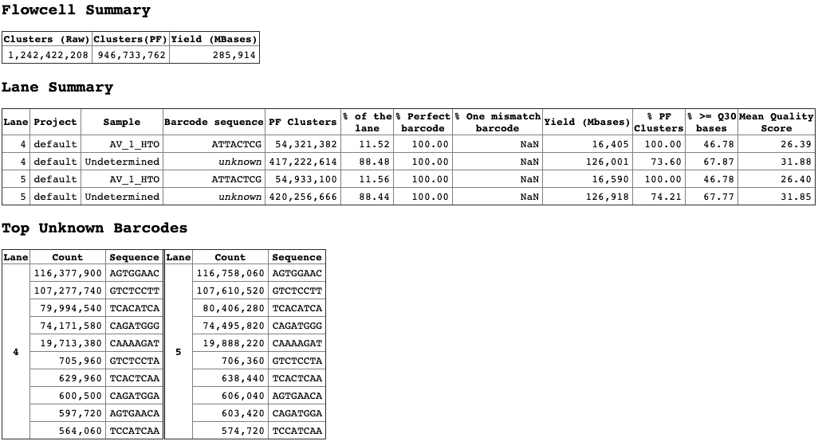
bcl2fastq --runfolder-dir 190826_E00603_0316_AH3GW3CCX2/ --output-dir HTO/ --sample-sheet samples_HTO.csv --barcode-mismatches 0
output-dir: HTO/Reports/html/flowcellID/all/all/all/laneBarcode.html

Slide 7
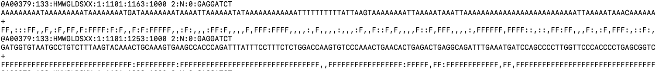
FASTQ
NGS data is often in FASTQ format
FASTQ is a text-based format for storing both sequence and its corresponding quality score
Four lines per sequence (read)
@ followed by the unique sequence identifier
The nucleotide sequence
+ The quality line break
The quality scores in ASCII characters
Get bcl files
Create fastq files
Overall QC (optional adapter trimming)
Align fastq to genome→SAM/BAM file
Quantify and collapse UMI
Final count matrix
View FASTQ Files
Viewing entire file
cat file1.fastq
Viewing first 10 lines
head file1.fastq

Slide 8
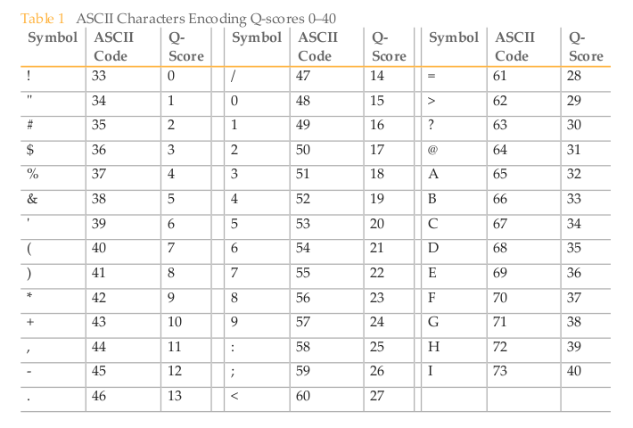
FASTQ
Header
Instrument
RunID
FlowcellID
Read Number (Paired 2/2)
Index Sequence
The quality score is associated to a probability of error, of an incorrect base call
Q = -10log₁₀(e) where e is the estimated probability of the base call being wrong.
Higher Q scores indicate a smaller probability of error.
Lower Q scores can result in a significant portion of the reads being unusable.
Quality Score Probability of Incorrect Base Call Inferred Base Call Accuracy
10 (Q10) 1 in 10 90%
20 (Q20) 1 in 100 99%
30 (Q30) 1 in 1000 99.9%

Slide 9
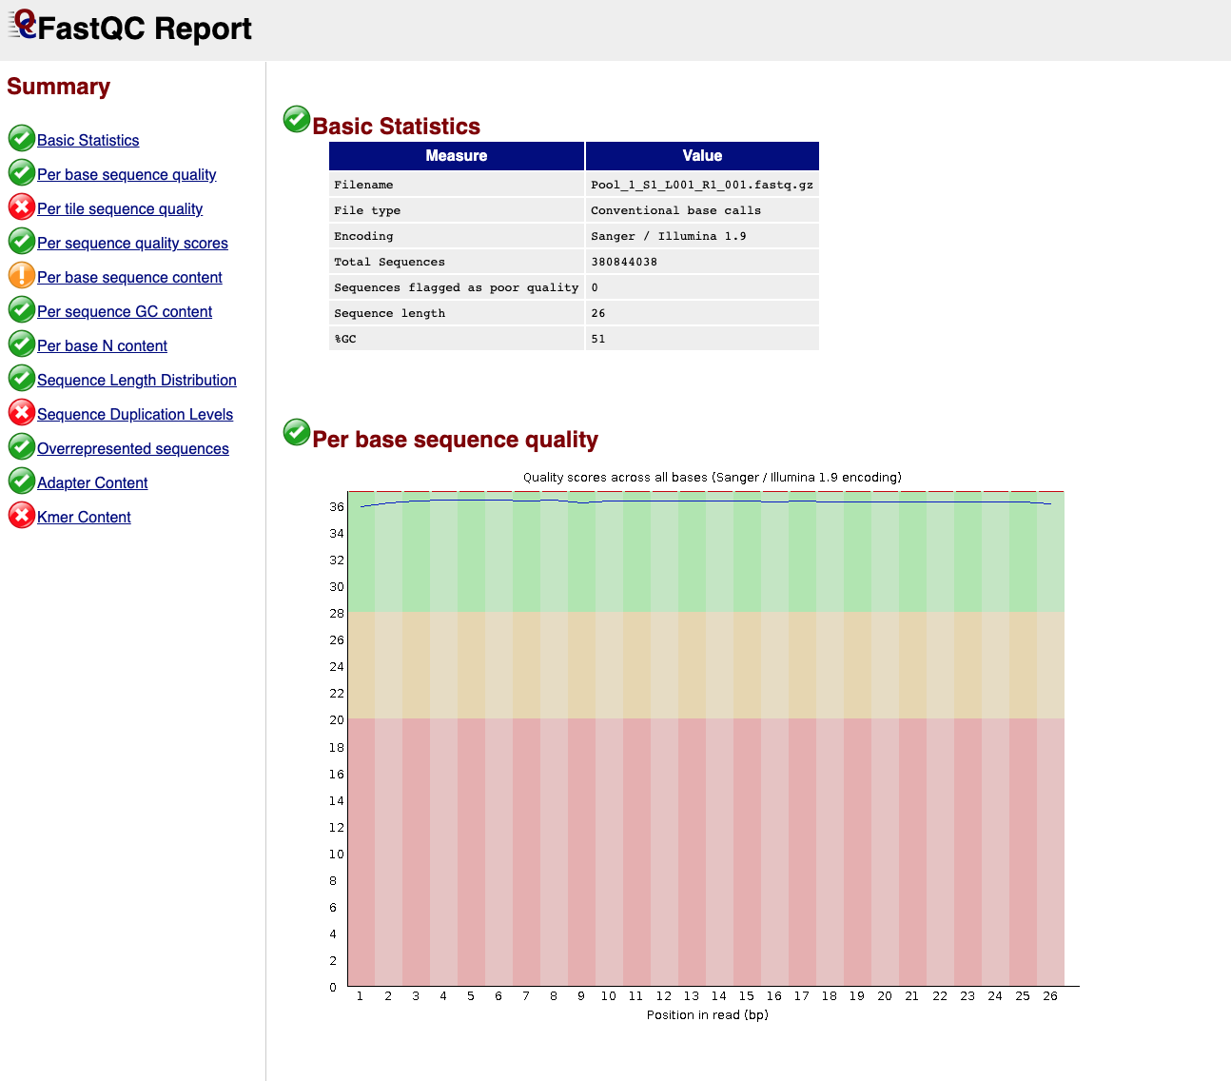
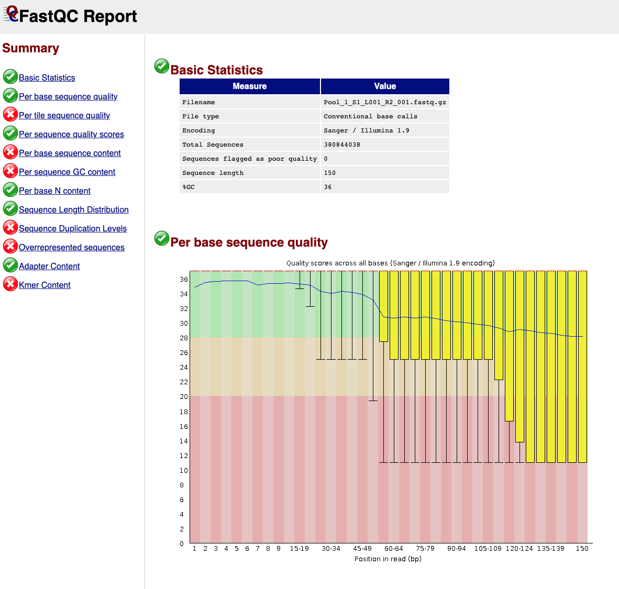
FASTQC
Before analyzing the data to draw biological conclusions you should always perform some simple quality control
FastQC aims to provide a QC report which can spot problems which originate either in the sequencer or in the starting library material
Read1
Read2

Slide 10
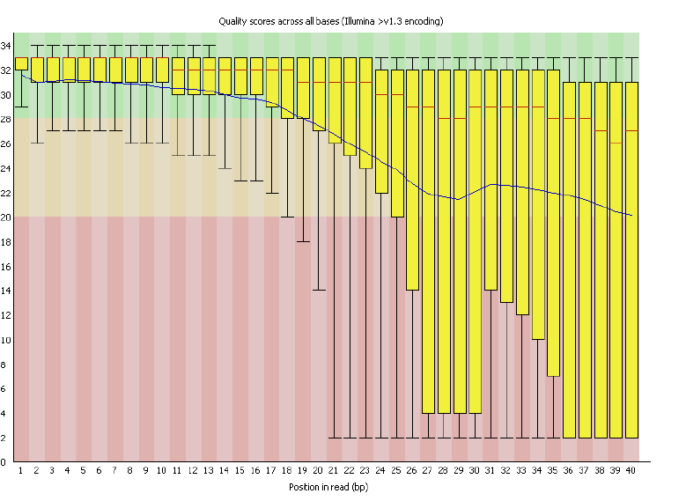
Per Base Sequence Quality
This view shows an overview of the range of quality values across all bases at each position in the FastQ file.
Good
Reasonable
Poor

Slide 11
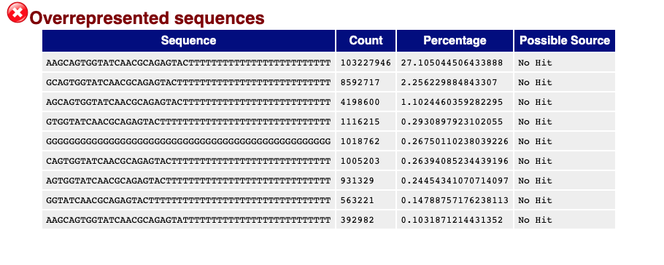
Overrepresented Sequences
A normal high-throughput library will contain a diverse set of sequences, with no individual sequence making up a tiny fraction of the whole.
This module lists all of the sequence which make up more than 0.1% of the total. Hits must be at least 20bp in length and have no more than 1 mismatch.
Finding a hit doesn't necessarily mean that this is the source of the contamination
Warning
This module will issue a warning if any sequence is found to represent more than 0.1% of the total.
Failure
This module will issue an error if any sequence is found to represent more than 1% of the total.
Typical artifacts
Primers, sequence adapters

Slide 12


Slide 13
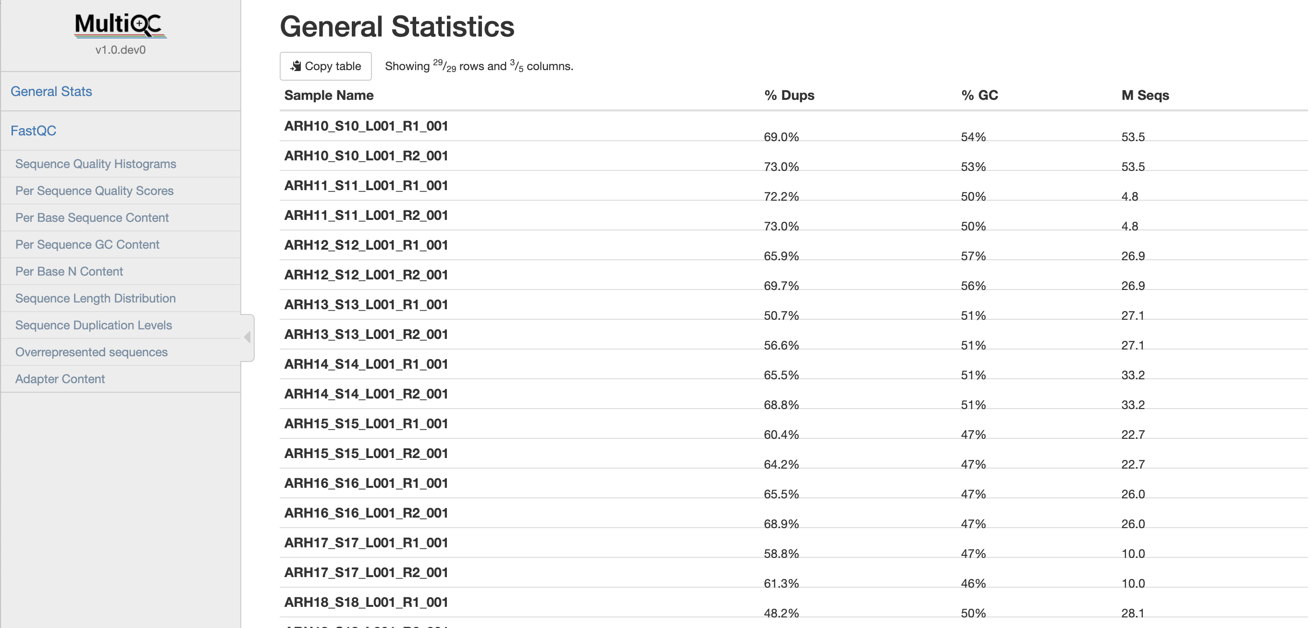

Slide 14
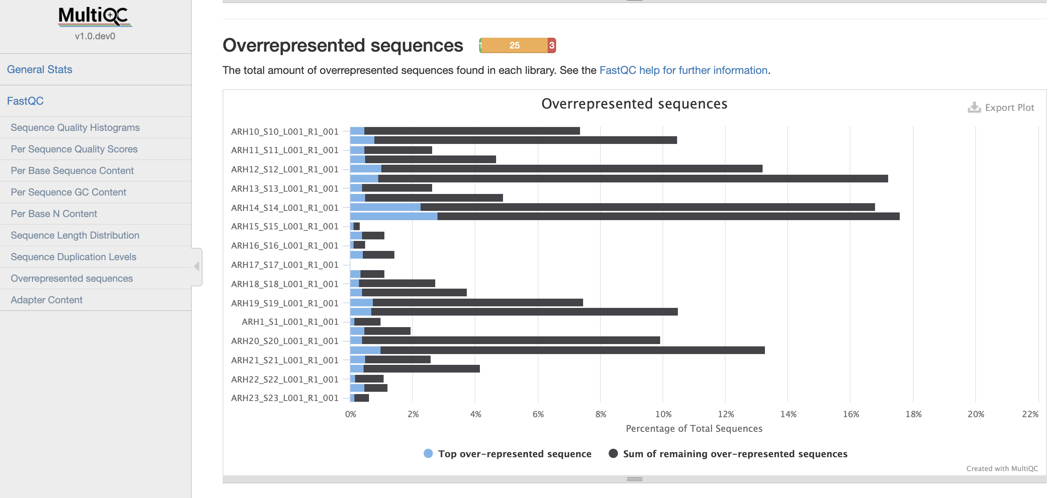

Slide 15
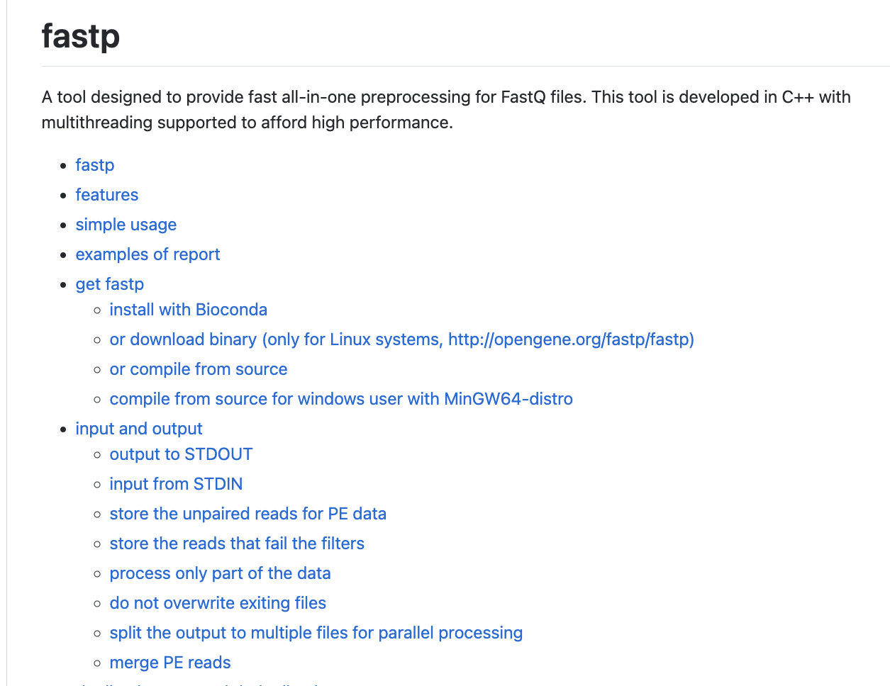
fastp
https://github.com/OpenGene/fastp

Slide 16
fastp
UMI example
The original read:
@NS500713:64:HFKJJBGXY:1:11101:1675:1101 1:N:0:TATAGCCT+GACCCCCA AAAAAAAAGCTACTTGGAGTACCAATAATAAAGTGAGCCCACCTTCCTGGTACCCAGACATTTCAGGAGGTCGGGAAA + 6AAAAAEEEEE/E/EA/E/AEA6EE//AEE66/AAE//EEE/E//E/AA/EEE/A/AEE/EEA//EEEEEEEE6EEAA
After it's processed with command:
fastp -i R1.fq -o out.R1.fq -U --umi_loc=read1 --umi_len=8:
@NS500713:64:HFKJJBGXY:1:11101:1675:1101:AAAAAAAA 1:N:0:TATAGCCT+GACCCCCA GCTACTTGGAGTACCAATAATAAAGTGAGCCCACCTTCCTGGTACCCAGACATTTCAGGAGGTCGGGAAA + EEE/E/EA/E/AEA6EE//AEE66/AAE//EEE/E//E/AA/EEE/A/AEE/EEA//EEEEEEEE6EEAA

Slide 17
Sequence filtering
Adapter trimming
Quality trimming
Trimming fixed length
Tools
Cutadapt
SeqTK
Trimmomatic
fastp

Slide 18
Aligning reads to a reference
Get bcl files
Create fastq files
Overall QC (optional adapter trimming)
Align fastq to genome→SAM/BAM file
Quantify and collapse UMI
Final count matrix
FASTQ files contain sequence information that we wish to map to genes in a genome:
Select your genome
Select your gene annotation file (generally gtf format)
Run the alignment program
Result of alignment is generally stored in a sam/bam file
Aligners
STAR, Kallisto, Bowtie

Slide 19
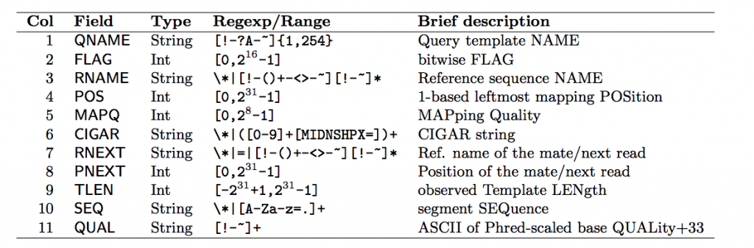
SAM Format
This is the most basic, human readable format, generated by almost every alignment algorithm that exists. It consists of a header, a row for every read in your dataset, and 11 tab-delimited fields describing that read.
SAM Header
The full list of available header fields can be found below
http://samtools.github.io/hts-specs/SAMv1.pdf

Slide 20
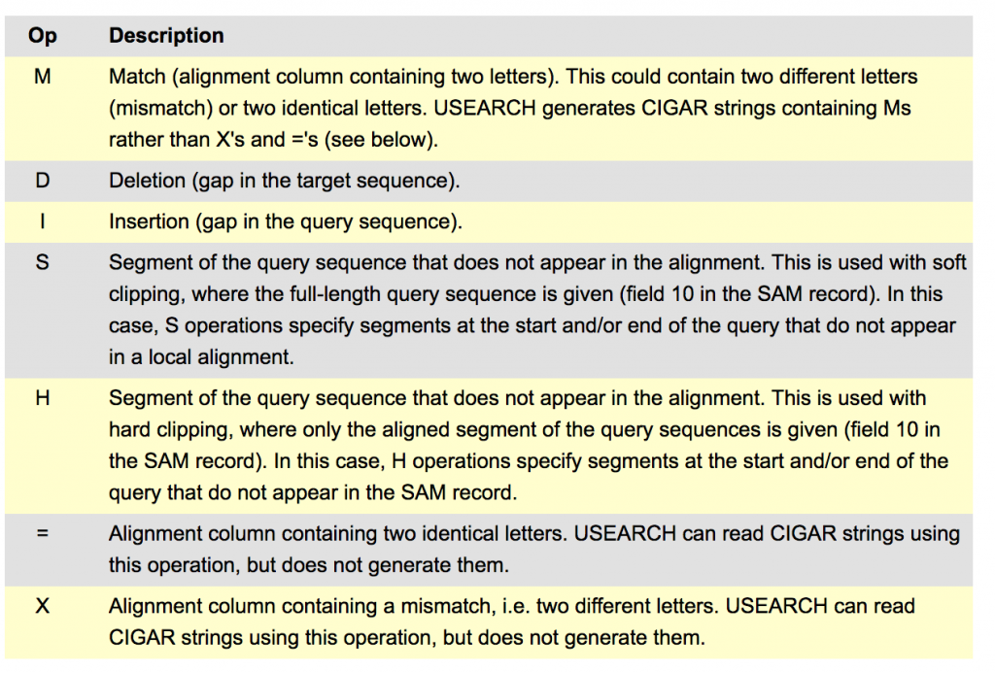
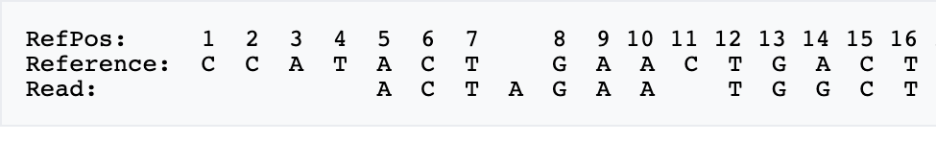
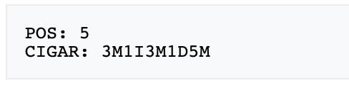
MapQ (Mapping Quality)
This value reports how well the read aligned to the reference. Different algorithms report it differently but nonetheless, the greater the number the better the alignment (generally).
CIGAR String
This is a shorthand way to encode an entire alignment:

Slide 21
BAM format
This is the same format except that it encoded in binary which means that it is significantly smaller than the SAM files and significantly faster to read, though it is not human legible and needs to be converted to another format (i.e. SAM) in order to make sense to us.
Some special tools are needed in order to make sense of BAM, such as Samtools, Picard Tools
View BAM Files
samtools view alignment.bam | head

Slide 22
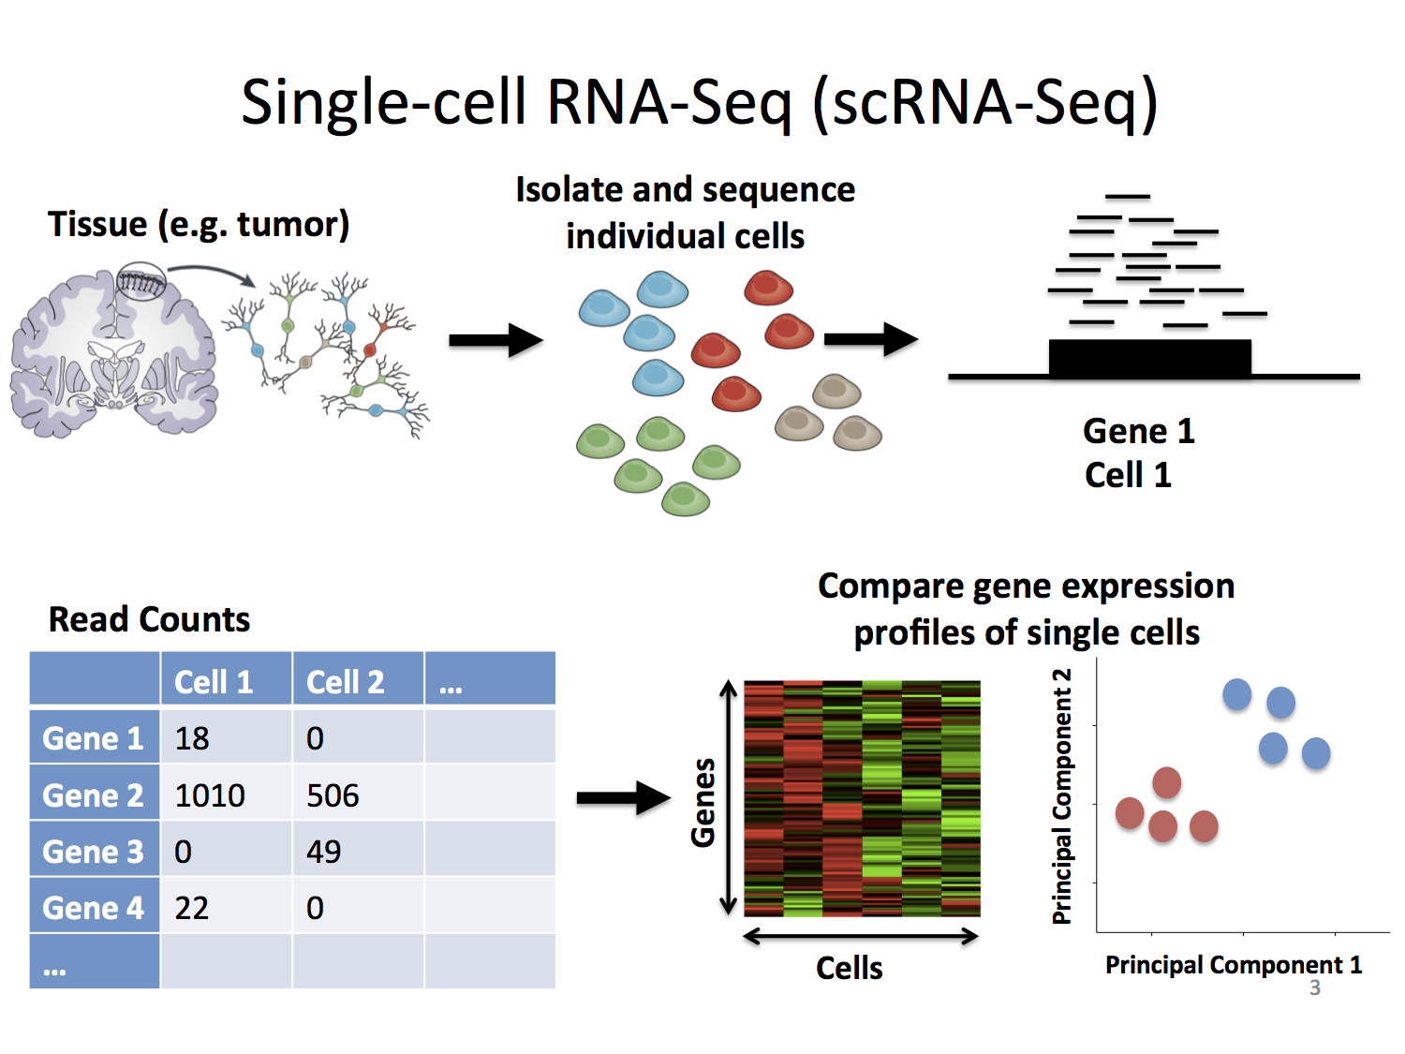
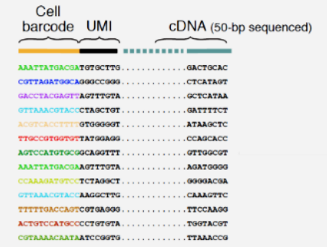

Slide 23
Differences between the methods are in how they capture a cell and quantify gene expression (either full-length or tag-based).
Full-length capture tries to achieve a uniform coverage of each transcript (many reads per transcript).
Tag-based protocols only capture either the 5’- or 3’-end of each transcript (single read per transcript). Choice in method determines what types of analyses the data can be used for.
Full-length capture can be used to distinguish different iso-forms, where tag-based method is best used for only gene abundance.
Tag-based 3’ counting techniques
1 read per transcript
Based on polyA
Expression analysis only
Fewer reads per cell needed (~20K reads/cell 10x V3+)
Less noise in expression patterns
Full-length
Based on polyA
Expression analysis
Splicing information
The more information desired beyond expression, the higher the reads needed per cell (~50K reads/cell to 10M reads/cell)

Slide 24
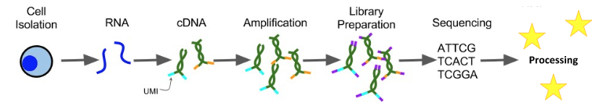
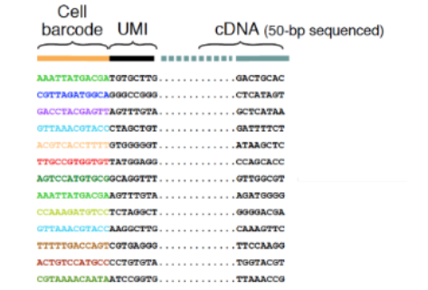
Challenges in single cell data analysis
Amplification artifacts
Dropouts
With high number of PCR cycles, some transcript become over represented in the final library
UMI are unique molecule identifier added to the transcript during RT step
UMI enable sequencing reads to be assigned to individual transcript molecules and removal of amplification noise and biases

Slide 25
10X technology and Cell Ranger
Cell Ranger is a set of analysis pipelines that process Chromium single-cell RNA-seq output to align reads, generate gene-barcode matrices and perform clustering and gene expression analysis. Cell Ranger includes five pipelines relevant to single-cell gene expression experiments:
cellranger mkfastq demultiplexes raw base call (BCL) files generated by Illumina sequencers into FASTQ files. It is a wrapper around Illumina's bcl2fastq, with additional features that are specific to 10x libraries and a simplified sample sheet format.
cellranger count takes FASTQ files from cellranger mkfastq and performs alignment, filtering, barcode counting, and UMI counting. It uses the Chromium cellular barcodes to generate feature-barcode matrices, determine clusters, and perform gene expression analysis. The count pipeline can take input from multiple sequencing runs on the same GEM well. It can also processes Feature Barcode data alongside Gene Expression reads.
cellranger aggr aggregates outputs from multiple runs of cellranger count, normalizing those runs to the same sequencing depth and then recomputing the feature-barcode matrices and analysis on the combined data.
cellranger reanalyze reruns the dimensionality reduction, clustering, and gene expression algorithms using tunable parameter settings.
cellranger multi is used to analyze Cell Multiplexing data. The cellranger multi pipeline also supports the analysis of Feature Barcode data.

Slide 26
How to run the 10X cellranger software?
Pipeline download and installation
https://support.10xgenomics.com/single-cell-gene-expression/software/pipelines/latest/using/tutorial_in

Slide 27
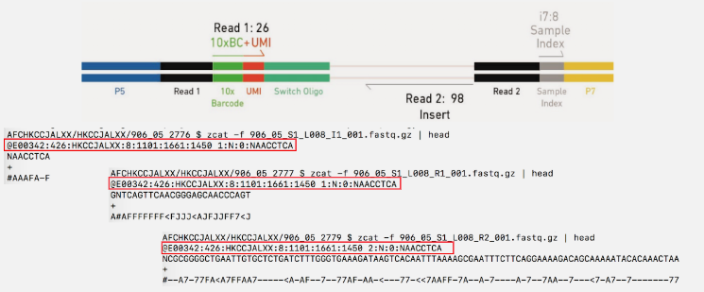
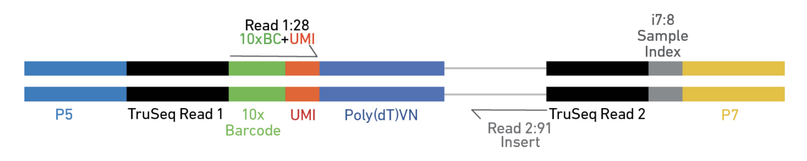
Cellranger mkfastq produces : Index.fastq; R1.fastq; R2.fastq
Cell Ranger mkfastq
cellranger mkfastq --id=my_data --run=/path/to/bcl --csv=samplesheet.csv
index
Read1
Read2

Slide 28
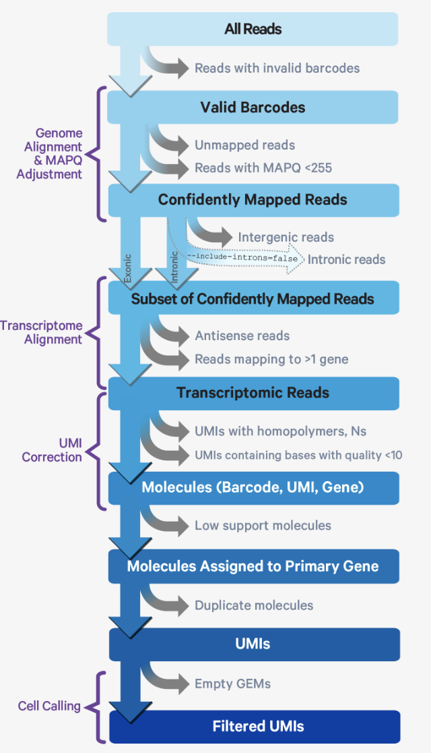
10X Cell Ranger count pipeline

Slide 29
Gene Expression Algorithms Overview
Read trimming: Cellranger only performs read trimming to 3’ gene expression assays.
A full length cDNA construct is flanked by the 30 bp template switch oligo (TSO) sequence on the 5’ end and poly-A on the 3’ end.
Reads derived from short RNA molecules are more likely to contain either or both TSO and poly-A sequence than longer RNA molecules.
In order to improve mapping, the TSO sequence is trimmed from the 5’ end of read 2 and poly-A is trimmed from the 3’ end prior to alignment.
Genome Alignment
Cell Ranger uses an aligner called STAR, which peforms splicing-aware alignment of reads to the genome. Cell Ranger then uses the transcript annotation GTF to categorize the reads into exonic, intronic, and intergenic, and by whether the reads align (confidently) to the genome. A read is exonic if at least 50% of it intersects an exon, intronic if it is non-exonic and intersects an intron, and intergenic otherwise.
MAPQ adjustment
For reads that align to a single exonic locus but also align to 1 or more non-exonic loci, the exonic locus is prioritized and the read is considered to be confidently mapped to the exonic locus with MAPQ 255.
.

Slide 30
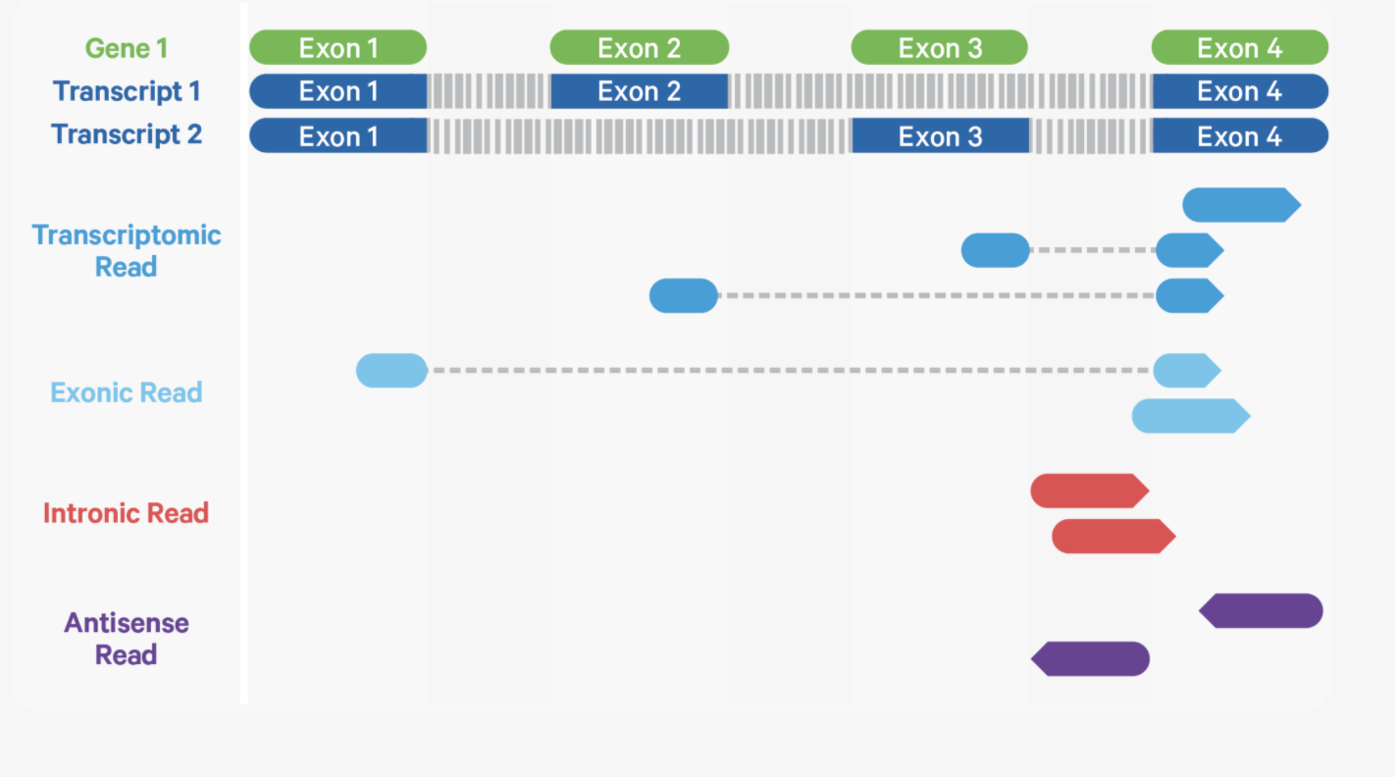
Transcriptome Alignment
Cell Ranger further aligns confidently mapped exonic and intronic reads to annotated transcripts by examining their compatibility with the transcriptome. As shown below, reads are classified based on whether they are sense or antisense and whether they are exonic, intronic, or have a splicing pattern compatible with transcript annotations associated with that gene. Cell Ranger prefers alignments with sense over antisense reads. A read is classified as antisense (purple) if it has any alignments to a transcript exon on the opposite strand and no sense alignments
transcriptomic reads are carried forward to UMI counting.
Cell Ranger ignores antisense reads

Slide 31
Starting in Cell Ranger 7.0, by default, the cellranger count and cellranger multi pipelines will include intronic reads for whole transcriptome gene expression analysis. Any reads that map in the sense orientation to a single gene - the reads labeled transcriptomic (blue) - are carried forward to UMI counting.
The default setting that includes intronic reads is recommended to maximize sensitivity, for example in cases where the input to the assay consists of nuclei, as there may be high levels of intronic reads generated by unspliced transcripts.
The fraction of gDNA was a small percentage of total UMIs (0.08%) and was a consistent 7-8% of features regardless of transcript length for the PBMC dataset (10X)

Slide 32
Gene Expression Algorithms Overview
Cell barcode and UMI filtering
Cell barcodes
Must be on static list of known cell barcode sequences
May be 1 mismatch away from the list if the mismatch occurs at a low- quality position (the barcode is then corrected).
UMIs (Unique Molecular Index)
Must not be a homopolymer, e.g. AAAAAAAAAA
Must not contain N
Must not contain bases with base quality < 10
UMIs that are 1 mismatch away from a higher-count UMI are corrected to that UMI if they share a cell barcode and gene.

Slide 33
Filtering cells (Cell Ranger)
Cellranger 3.0 introduces an improved cell-calling algorithm to identify populations of low RNA content cells, especially when low RNA content cells are mixed into a population of high RNA content cells.
E.g tumor samples often contain large tumor cells mixed with smaller tumor infiltrating lymphocytes (TIL).
The new algorithm is based on the EmptyDrops method (Lun et al., 2018).
The algorithm has two key steps:
It uses a cutoff based on total UMI counts of each barcode to identify cells. This step identifies the primary mode of high RNA content cells.
Then the algorithm uses the RNA profile of each remaining barcode to determine if it is an “empty” or a cell containing partition. This second step captures low RNA content cells whose total UMI counts may be similar to empty GEMs.

Slide 34
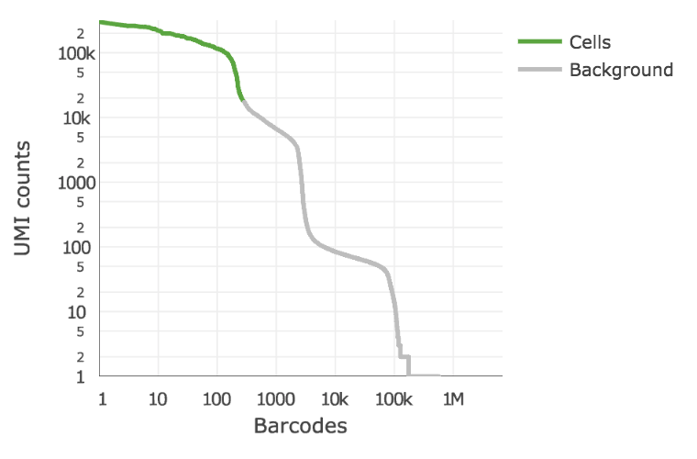
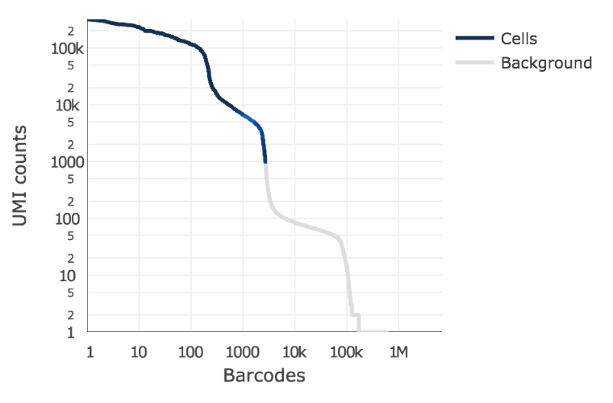
Barcodes selection steps
The original cellranger cell calling algorithm is used to identify high RNA content cells, using a cutoff based on the total UMI count for each barcode.
In the second step, a set of barcodes with low UMI counts that likely represent ‘empty’ GEM partitions is selected. A model of the RNA profile of selected barcodes is created. This second step identifies cells that are clearly distinguishable from the profile of empty GEMs, even though they may have much lower RNA content than the largest cells in the experiment.
Earlier version
Latest version
“Rescued” barcodes
Notes:
Below is an example of a challenging cell-calling scenario where 300 high RNA content 293T cells are mixed with 2000 low RNA content PBMC cells. On the left is the cell calling result with the cell calling algorithm prior to cellranger 3.0 and on the right is the current cellranger 3.0 result. You can see that low RNA content cells are successfully identified by the new algorithm

Slide 35
Alternative pipelines
10X data or other scRNAseq technologies can also rely on independent pipelines
STARsolo
Alevin
dropEst

Slide 36
How to run cell ranger count
Command-Line Argument Reference
Argument | Description
--id | A unique run ID string: e.g. sample345
--fastqs | Path of the fastq_path folder generated by cellranger mkfastq
--libraries | Path to a libraries.csv file declaring FASTQ paths and library types of input libraries. Required for feature-barcoding analysis. See Feature Barcoding Analysis page for details. When using this argument, --fastqs and --sample must not be passed.
--sample | Sample name as specified in the sample sheet supplied to cellranger mkfastq.
--transcriptome | Path to the Cell Ranger compatible transcriptome reference
--feature-ref | Path to a Feature Reference CSV file declaring the Feature Barcoding reagents in use in the experiment.
--expect-cells | (optional) Expected number of recovered cells.
--force-cells | (optional) Force pipeline to use this number of cells, bypassing the cell detection algorithm.
--chemistry | (optional)
--r1-length | (optional)
--r2-length | (optional) Hard-trim the input R2 sequence to this length.
--include-introns | (optional) Add this flag to count reads mapping to intronic regions. This may improve sensitivity for samples with a significant amount of pre-mRNA molecules, such as nuclei. This flag should be used instead of the deprecated pre-mRNA reference
https://support.10xgenomics.com/single-cell-gene-expression/software/pipelines/latest/using/count
Notes:
If you have multiple libraries for the sample, you will need to run cellranger count on them individually, and then combine them with cellranger aggr.

Slide 37
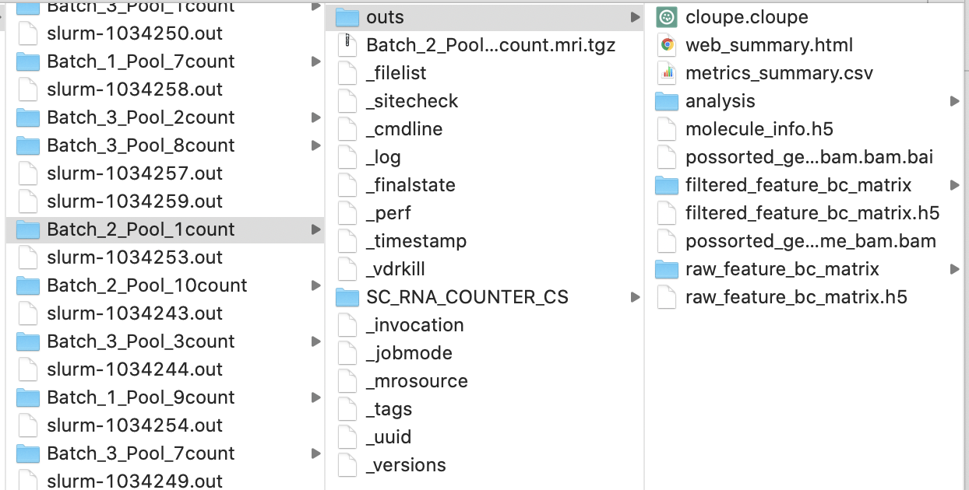
How to run cellranger count
path_to_cellranger/cellranger count --id=samplename(your choice) --transcriptome=path_to/refdata-gex-GRCh38-2020-A
--fastqs=path_to_flowcell/outs/fastq_path --sample=sample_prefix
output

Slide 38
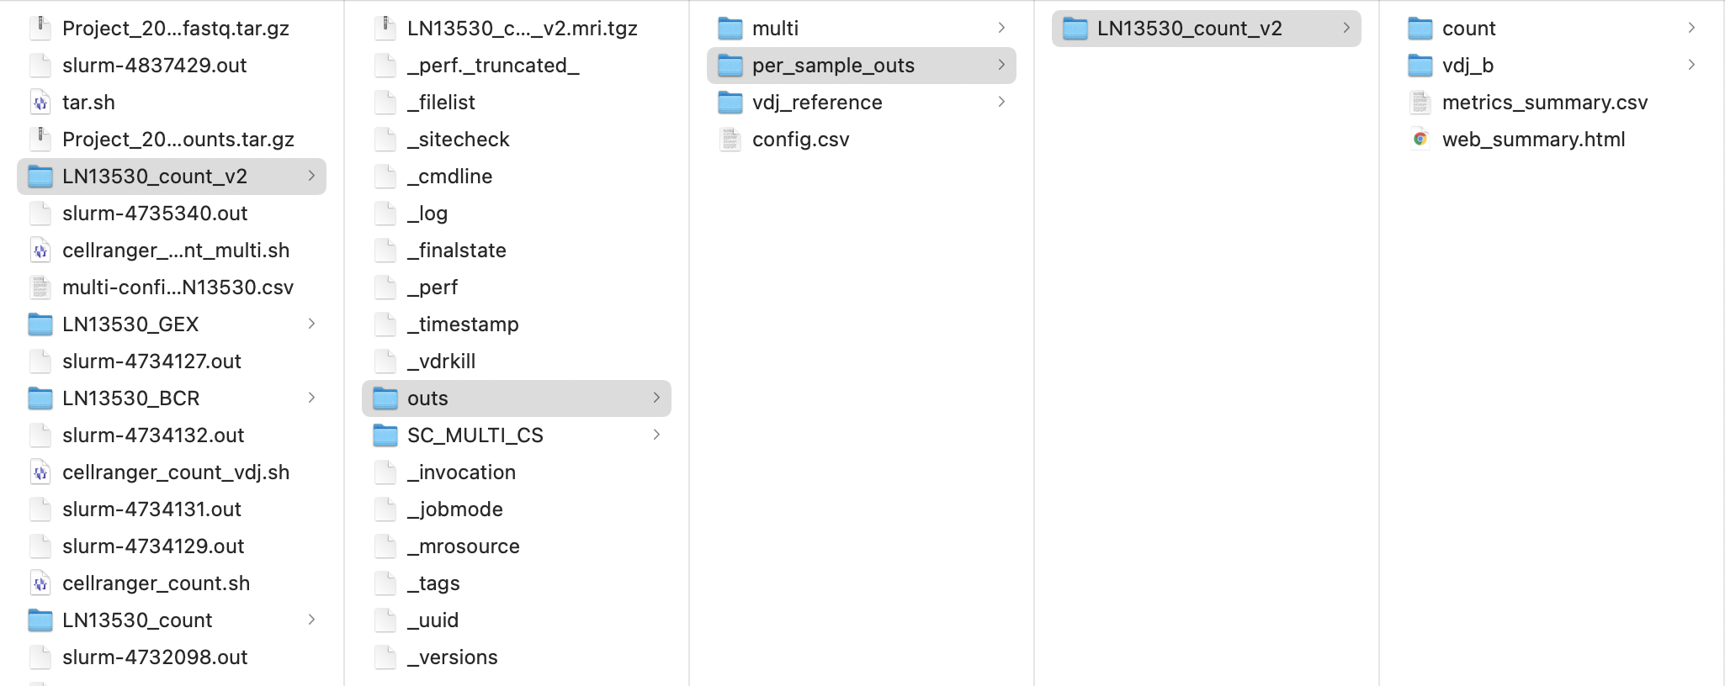
path_to_cellranger/cellranger-6.0.1/cellranger multi --id=samplename(your choice) --csv=multi-config.csv

Slide 39
Matrix output
With 3 files needed to completely describe each gene x cell matrix
matrix.mtx.gz
features.tsv.gz
barcode.tsv.gz
Type | Description
Raw | gene-barcode matrices Contains every barcode from fixed list of known-good barcode sequences. This includes background and non-cellular barcodes.
Filtered | gene-barcode matrices Contains only detected cellular barcodes.

Slide 40
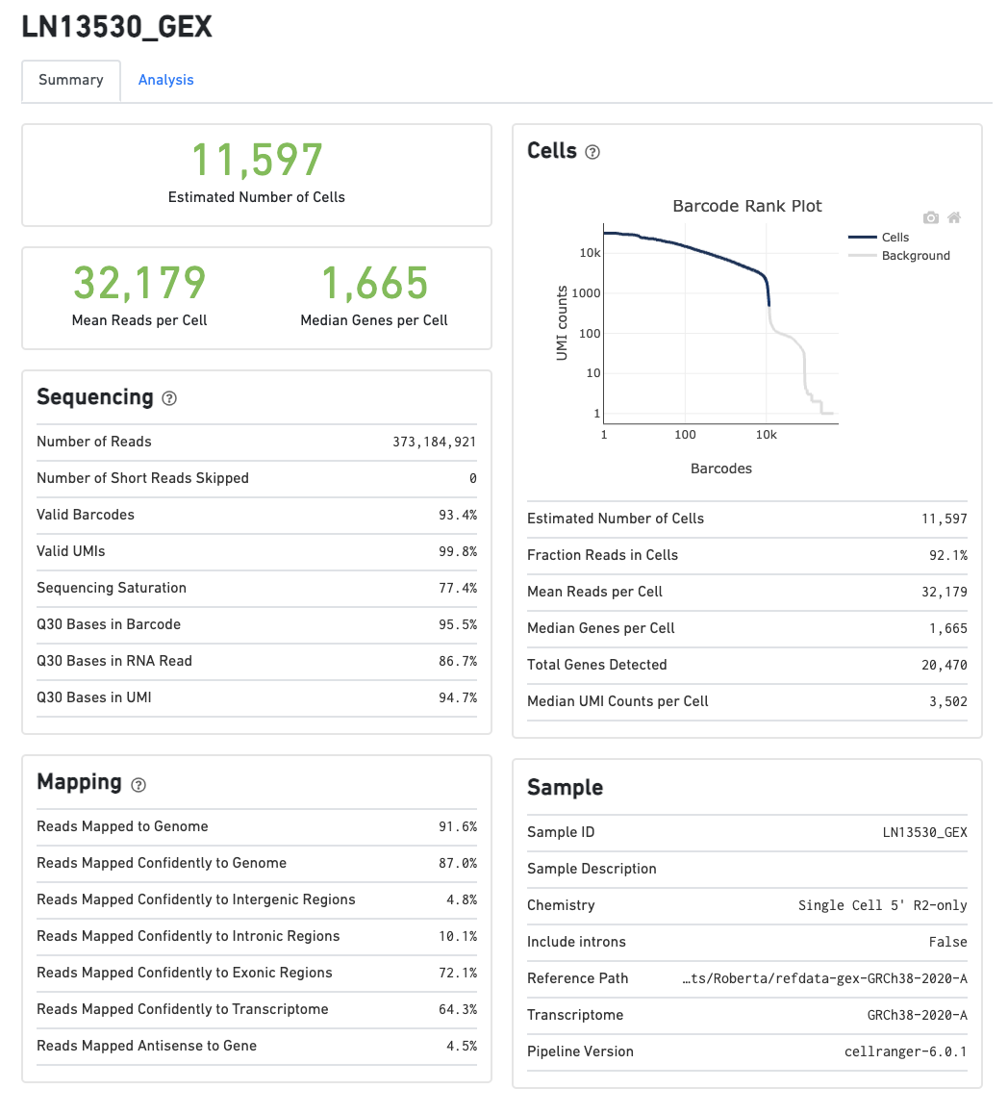
Web summary examples

Slide 42
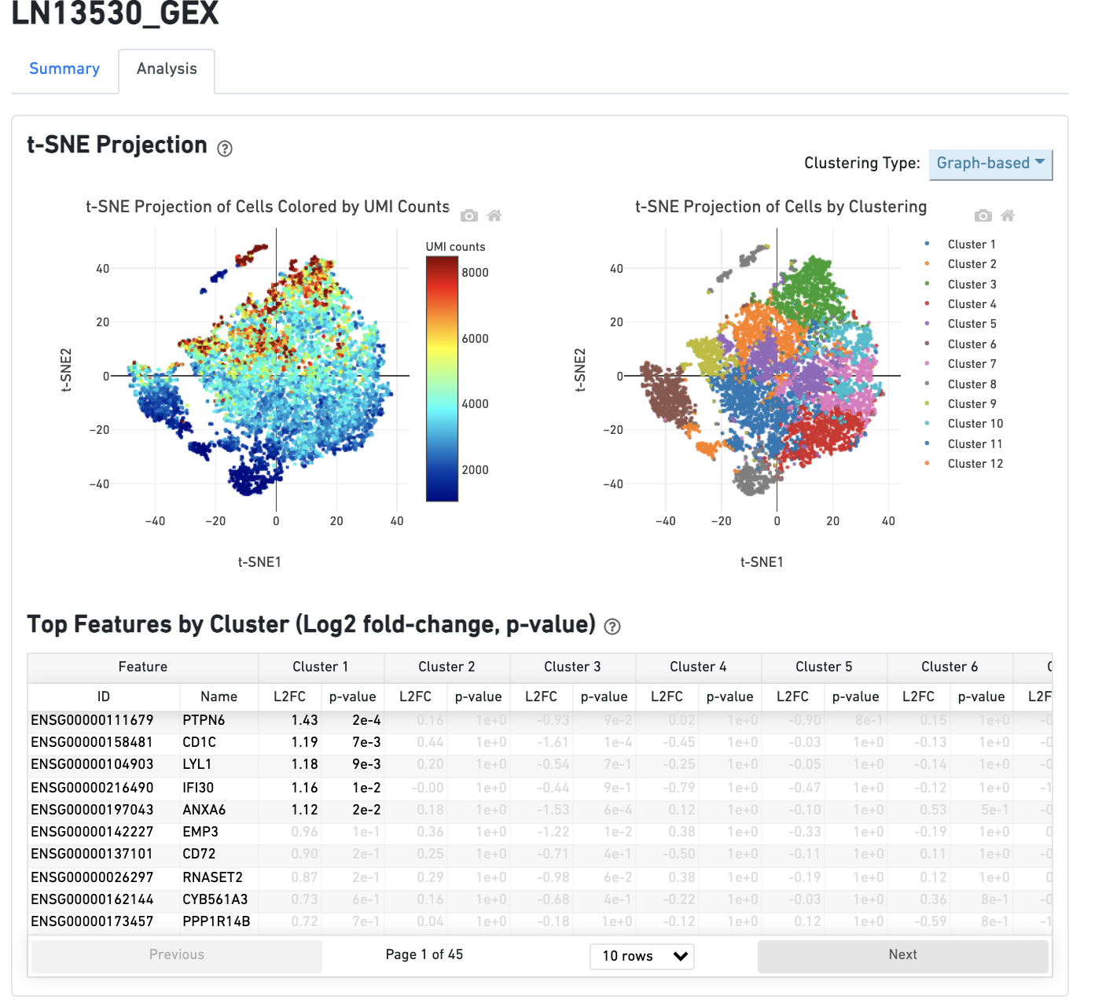

Slide 43
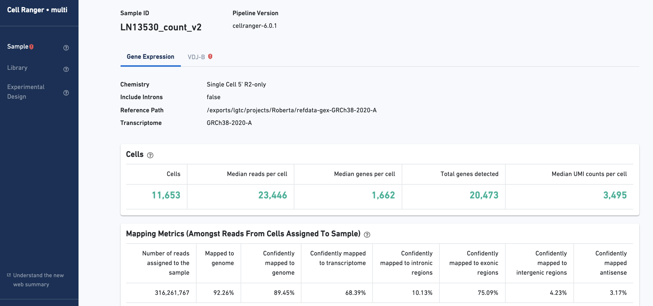

Slide 44
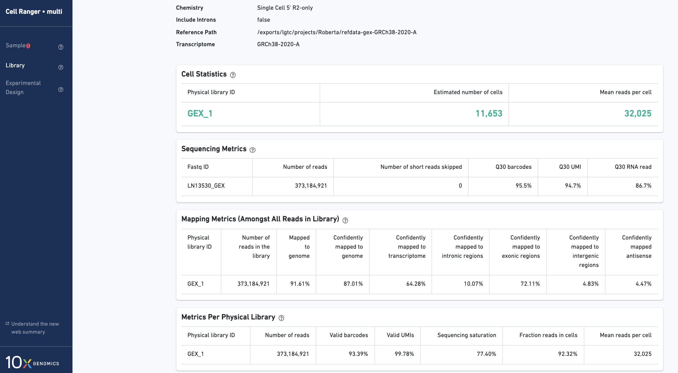

Slide 45
Metric | Description
Estimated Number of Cells | The number of barcodes associated with cell-containing partitions
Mean Reads per Cell | The total number of sequenced reads divided by the estimated number of cells.
Median Genes per Cell | The median number of genes detected (with nonzero UMI counts) across all cell-associated barcodes.
Number of Reads | Total number of sequenced reads.
Valid Barcodes | Fraction of reads with cell-barcodes that match the whitelist.
Reads Mapped to Genome | Fraction of reads that mapped to the genome.
Reads Mapped Confidently to Genome | Reads Mapped Confidently to Genome.
Reads Mapped Confidently to Transcriptome | Fraction of reads that mapped to a unique gene in the transcriptome with a high mapping quality score
Reads Mapped Confidently to Exonic Regions | Fraction of reads that mapped to the exonic regions of the genome with a high mapping quality score
Reads Mapped Confidently to Intronic Regions | Fraction of reads that mapped to the intronic regions of the genome with a high mapping quality score
Reads Mapped Confidently to Intergenic Regions | Fraction of reads that mapped to the intergenic regions of the genome with a high mapping quality score
Reads Mapped Antisense to Gene | Fraction of reads confidently mapped to the transcriptome, but on the opposite strand of their annotated gene.
Sequencing Saturation | The fraction of reads originating from an already-observed UMI. This is a function of library complexity and sequencing depth.
Q30 Bases in Barcode | Fraction of bases with Q-score at least 30 in the cell barcode sequences.
Q30 Bases in RNA Read | Fraction of bases with Q-score at least 30 in the RNA read sequences.
Q30 Bases in Sample Index | Fraction of bases with Q-score at least 30 in the sample index sequences.
Q30 Bases in UMI | Fraction of bases with Q-score at least 30 in the UMI sequences.
Fraction Reads in Cells | The fraction of cell-barcoded, confidently mapped reads with cell-associated barcodes.
Total Genes Detected | The number of genes with at least one UMI count in any cell.
Median UMI Counts per Cell | The median number of total UMI counts across all cell-associated barcodes.

Slide 46
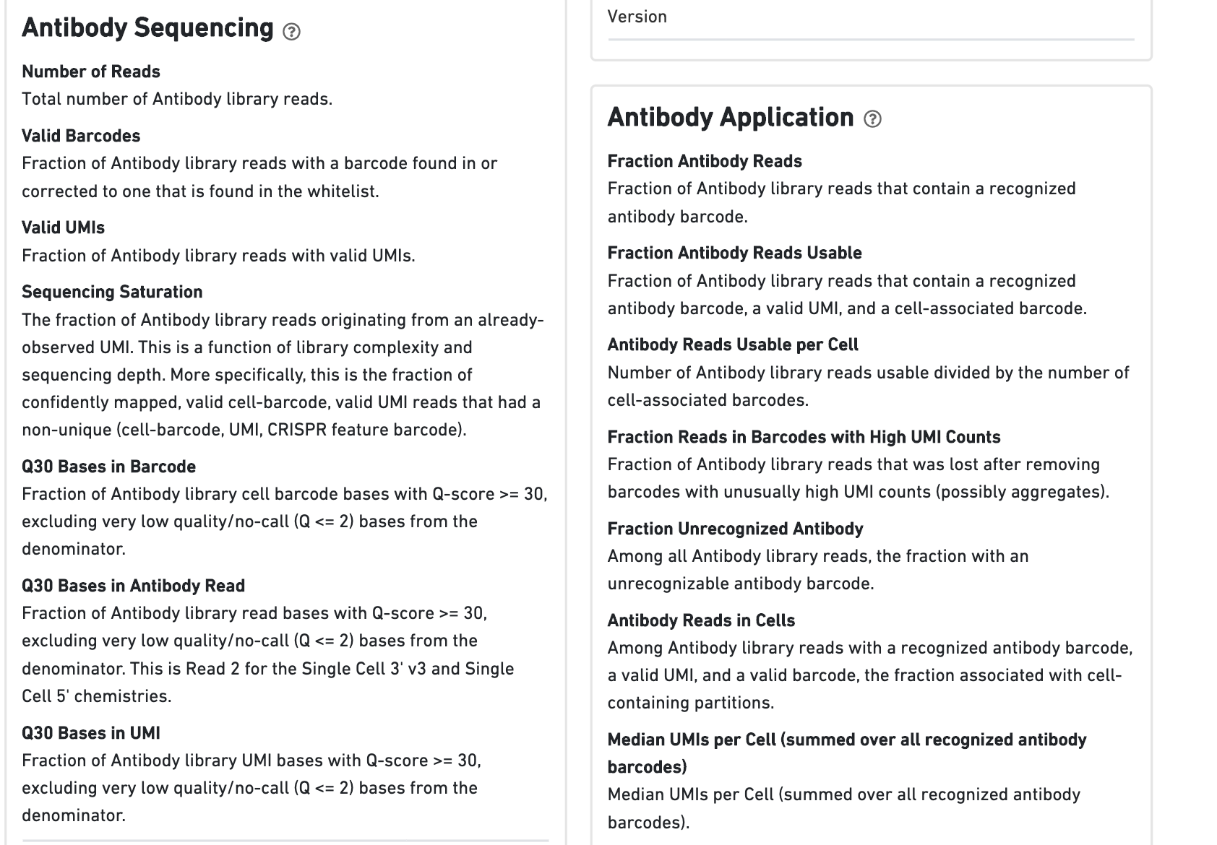
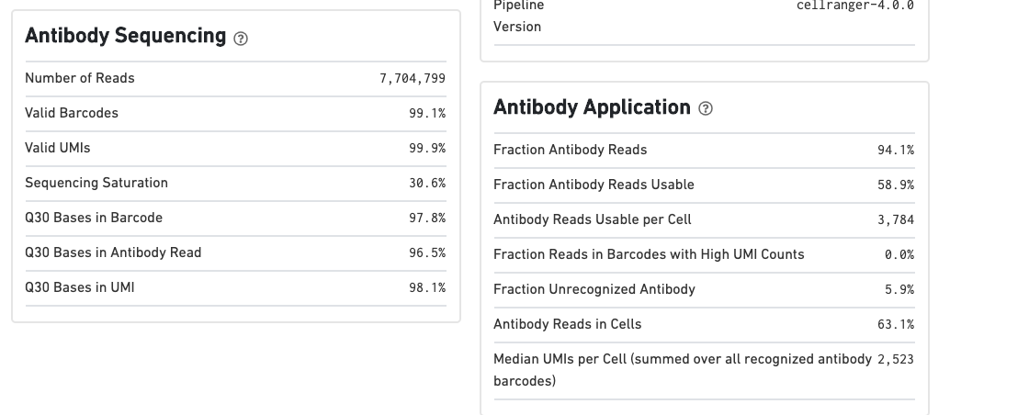

Slide 47
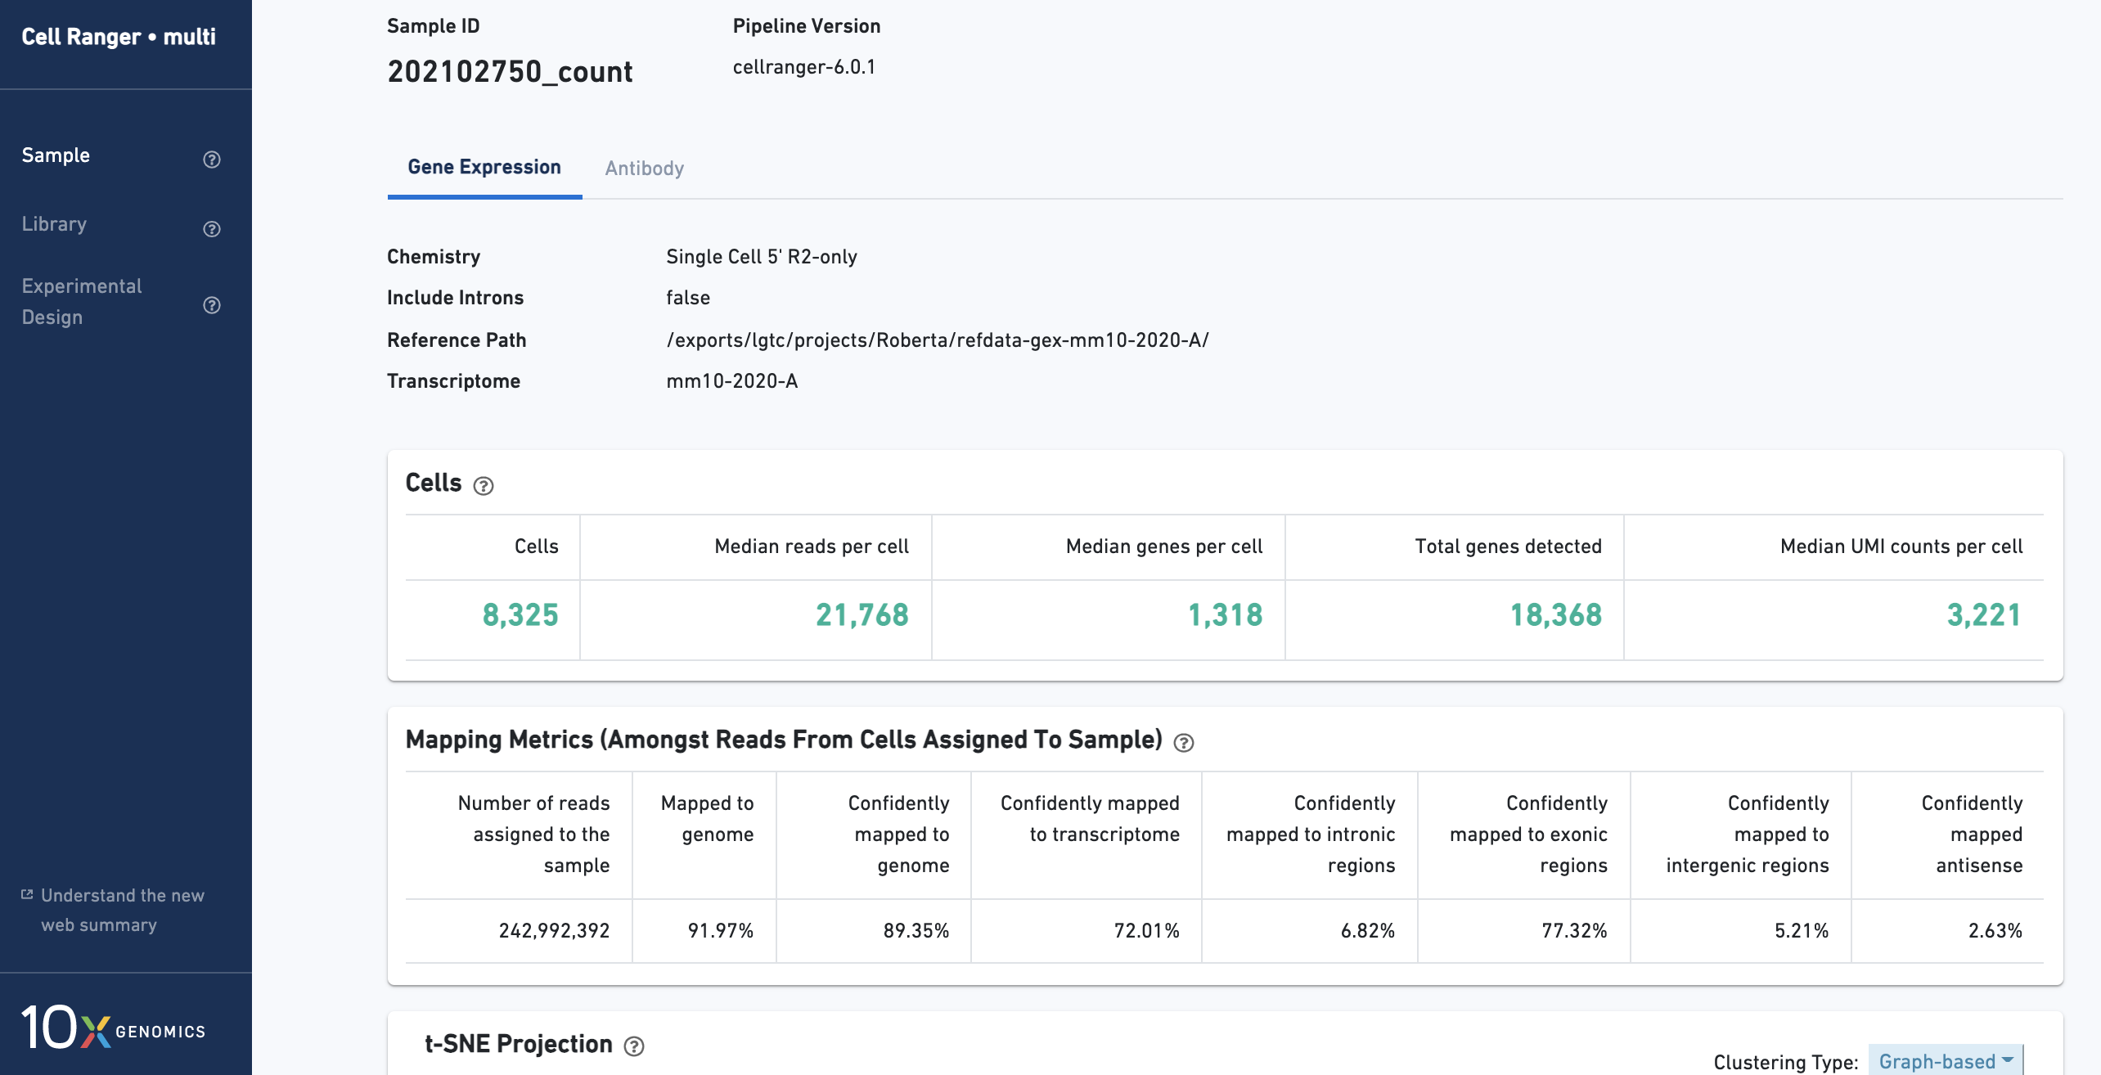

Slide 48
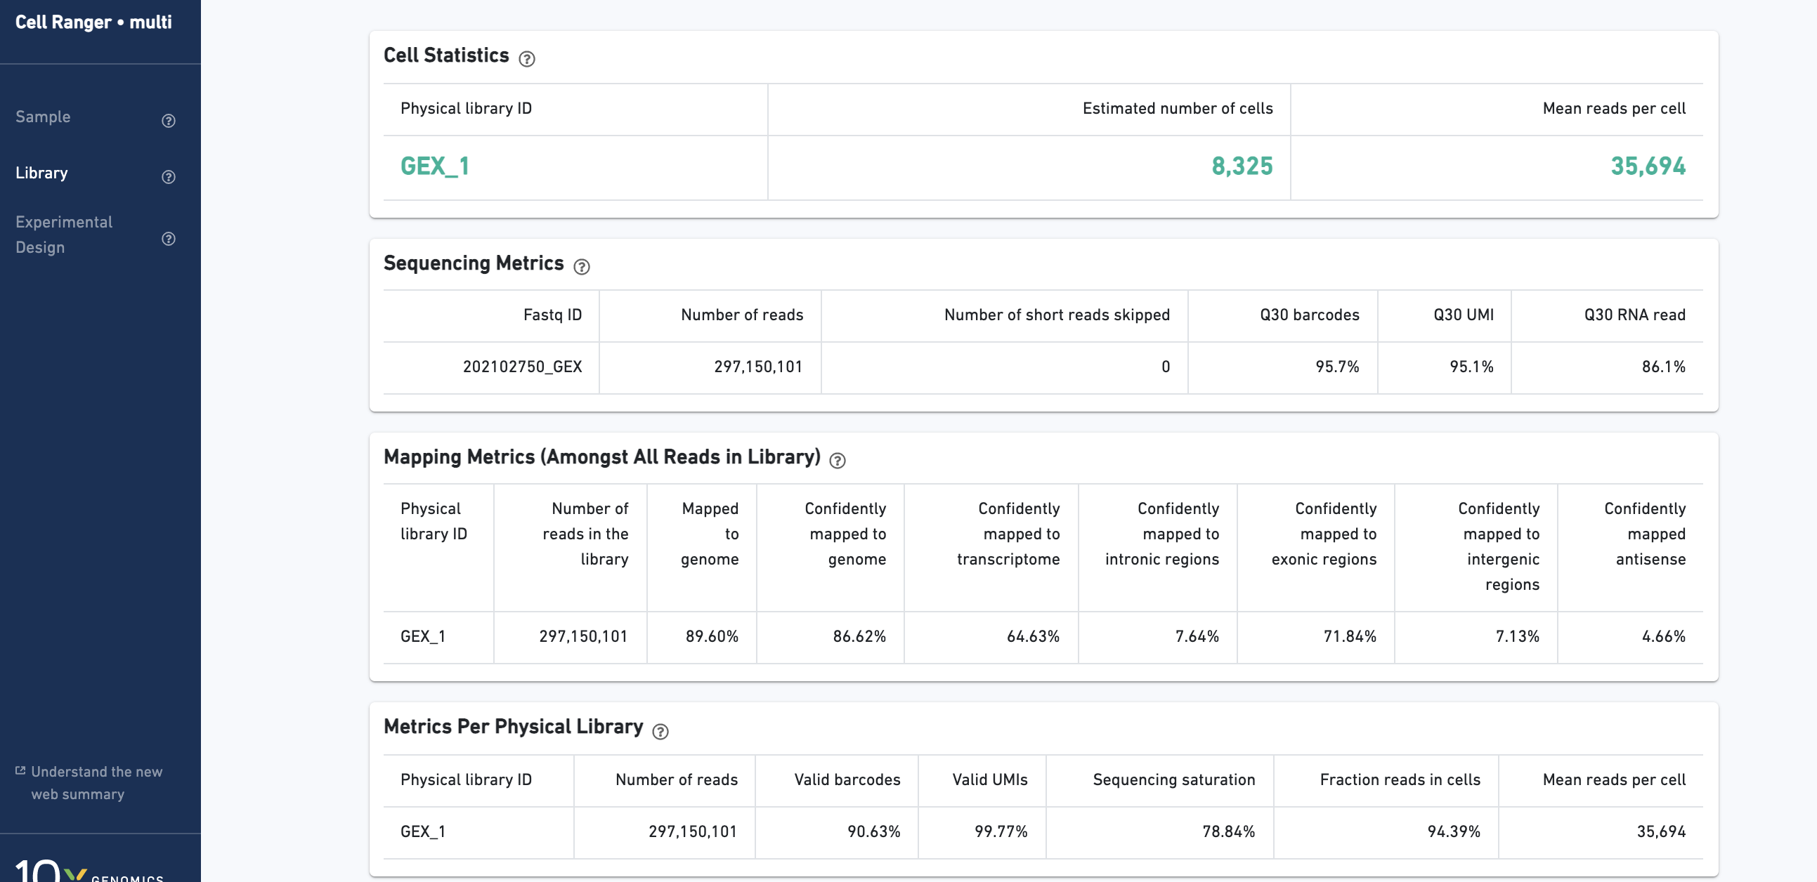

Slide 49
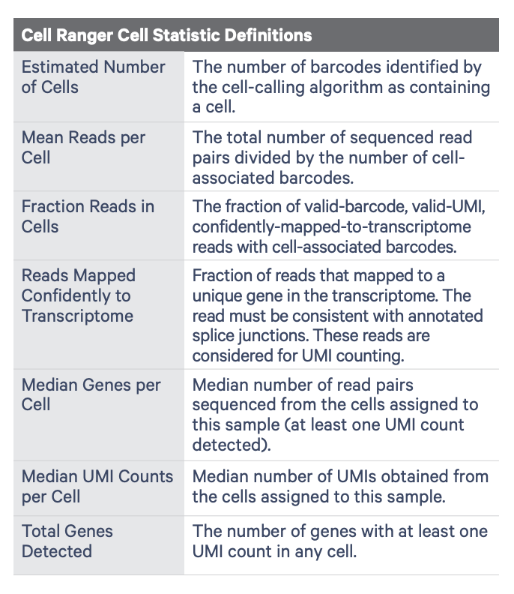
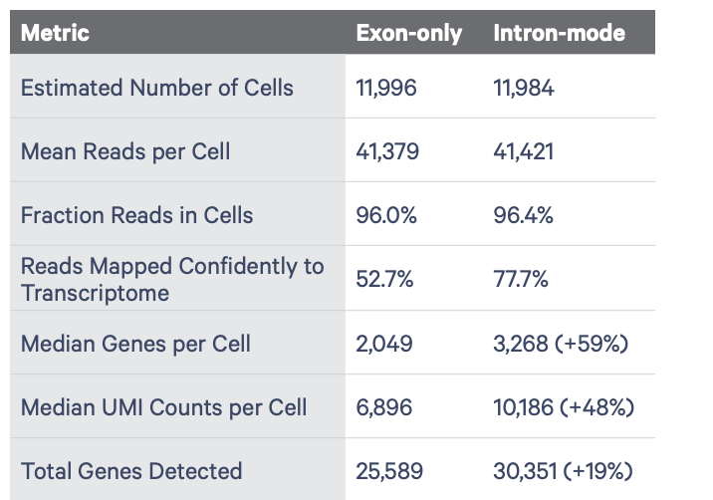

Slide 50
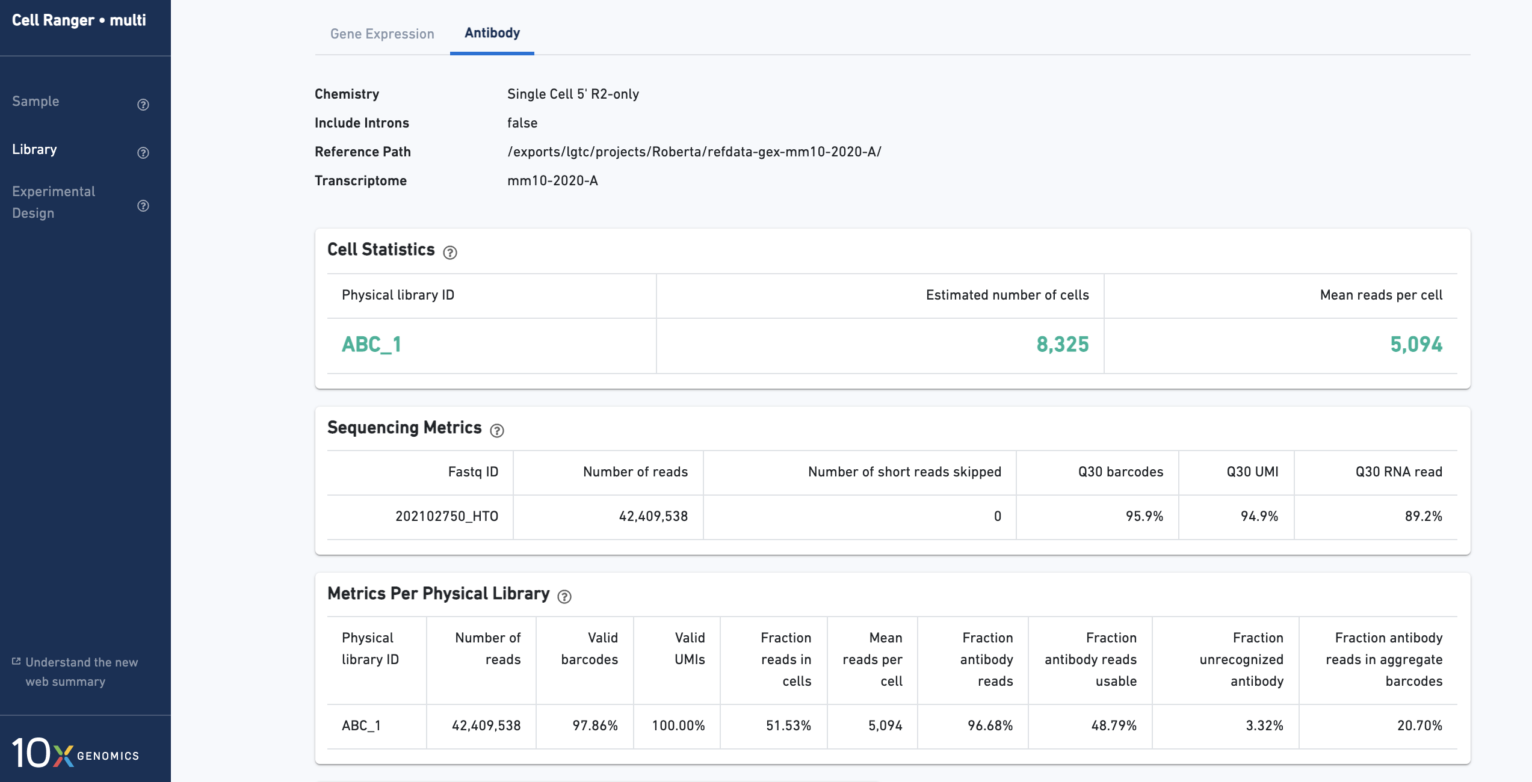

Slide 51
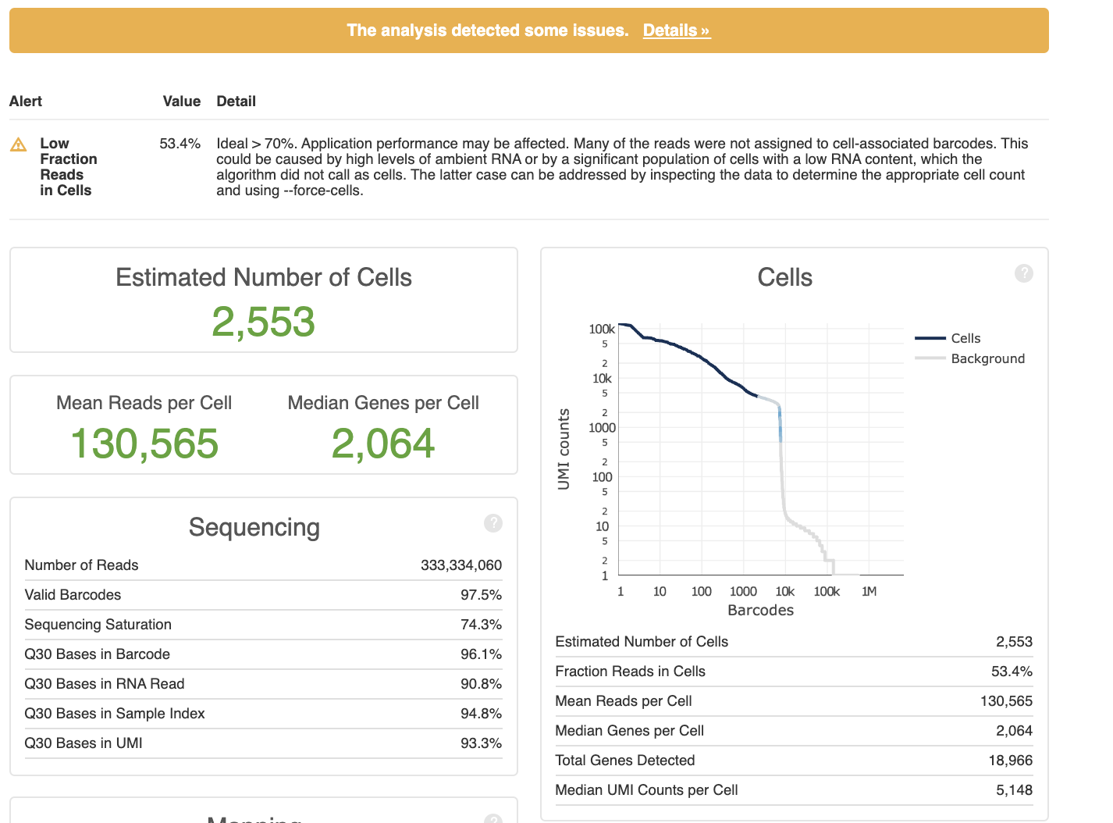

Slide 52
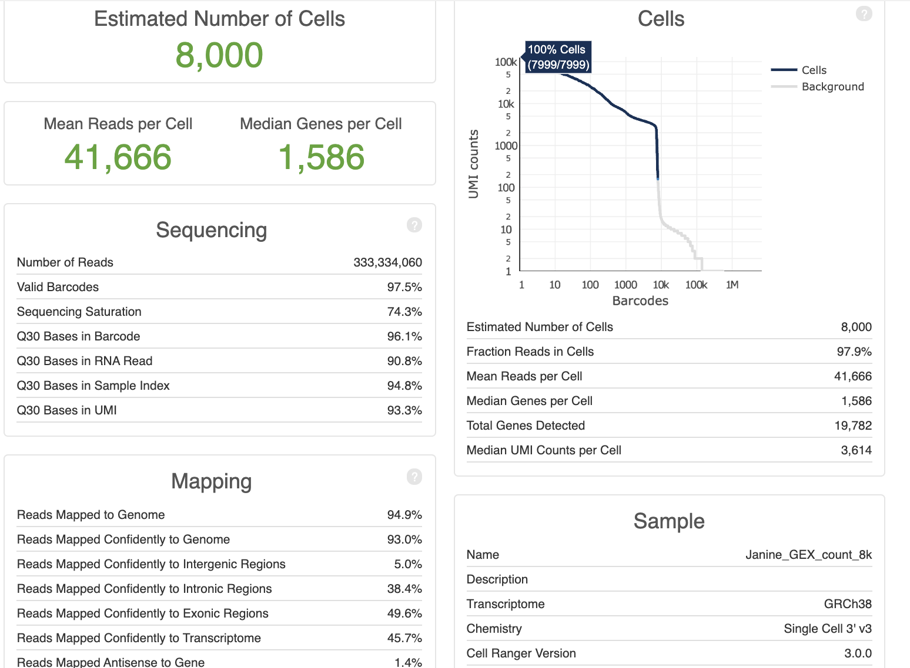
Forcing the number of cells

Slide 53
Conclusions
Always perform QC of your libraries!
Be aware of library specifics → critical mindset!

